Slide 1
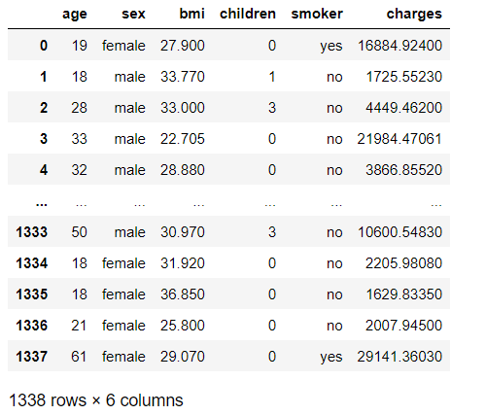
Problem Statement:
Insurance charges Prediction
Read the dataset and Retrieve the columns present in the dataset:
Data set has 1338 rows ,and 6 columns Note: By using shape attribute we can able to get the rows and columns count

Slide 2
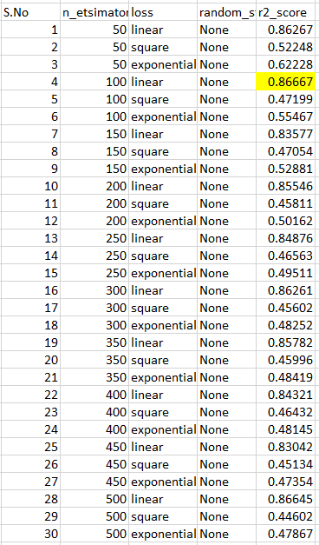
ADA BOOSTING:
The ADA BOOST regressor has the r2_scrore= 0.86667

Slide 3
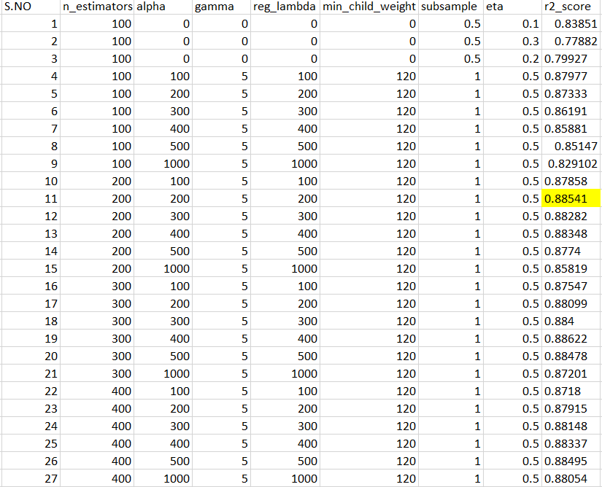
XGBOOST:
The XGBOOST regressor has the r2_scrore= 0.88541

Slide 4
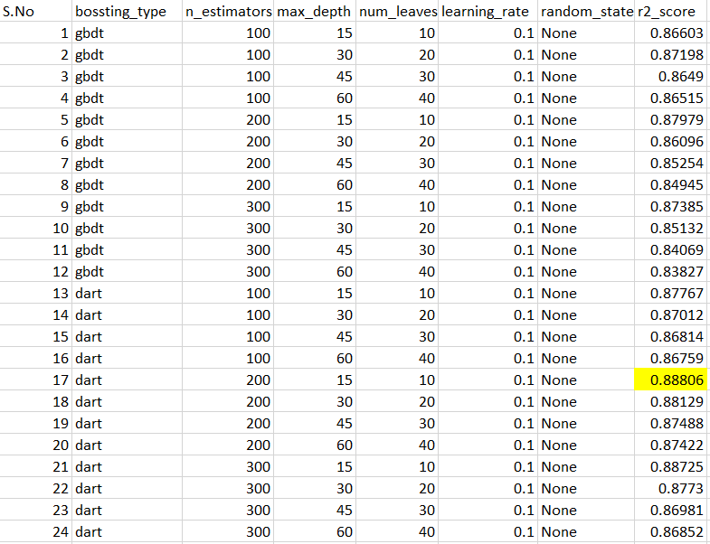
LGBM:
The LGBM regressor has the r2_scrore= 0.88806
Conclusion:
The Ada Boost , XGBoost, LGBM r2_scorevalues is < than 0.90
But comparing these three algorithm the XGBoost and LGBM algorithm performed good, The r2_score value is near 0.88. So that we can choose either anyone of them.

